Slide 1
Digital Portfolio
STUDENT NAME: Merlin Martina.S
REGISTER NO AND NMID: asunm1451222407505
DEPARTMENT: B.Sc., Computer Science
COLLEGE: Mahalashmi women’s college of arts and science
university of madras

Slide 2
PROJECT TITLE
DIGITAL
PORTFOLIO

Slide 3


AGENDA
Problem Statement
Project Overview
End Users
Tools and Technologies
Portfolio design and Layout
Features and Functionality
Results and Screenshots
Conclusion
Github Link
3/21/2024 Annual Review

Slide 4

PROBLEM STATEMENT
Students struggle to showcase their skills effectively.
Traditional resumes are static and limited.
Recruiters need a clear and dynamic representation of talent.
A digital portfolio provides an interactive solution.

Slide 5

PROJECT OVERVIEW
A web-based personal portfolio for students and professionals.
Highlights skills, projects, certifications, and achievements.
Provides a professional online presence.
Designed to be simple, responsive, and visually appealing.

Slide 6

WHO ARE THE END USERS?
Students & Freshers → Showcase achievements and skills.
Recruiters / HRs → Evaluate candidates effectively.
Institutions → Maintain a record of student projects.
Freelancers → Share work and attract clients.

Slide 7
TOOLS AND TECHNIQUES
Frontend: HTML, CSS, JavaScript
Database: MySQL / Firebase
Design Tools: Canva / Figma
Version Control: Git & GitHub
Hosting: GitHub Pages / Netlify

Slide 8
POTFOLIO DESIGN AND LAYOUT
Clean, modern, and responsive interface.
Sections include: About Me, Skills, Projects, Certifications,
Contact.
Attractive visual representation of achievements.
Easy navigation for smooth user experience
8

Slide 9
FEATURES AND FUNCTIONALITY
Fully responsive and mobile-friendly.
Integrates GitHub to showcase coding projects.
Supports uploading certificates, resumes, and achievements.
Simple, interactive, and user-friendly design.

Slide 10
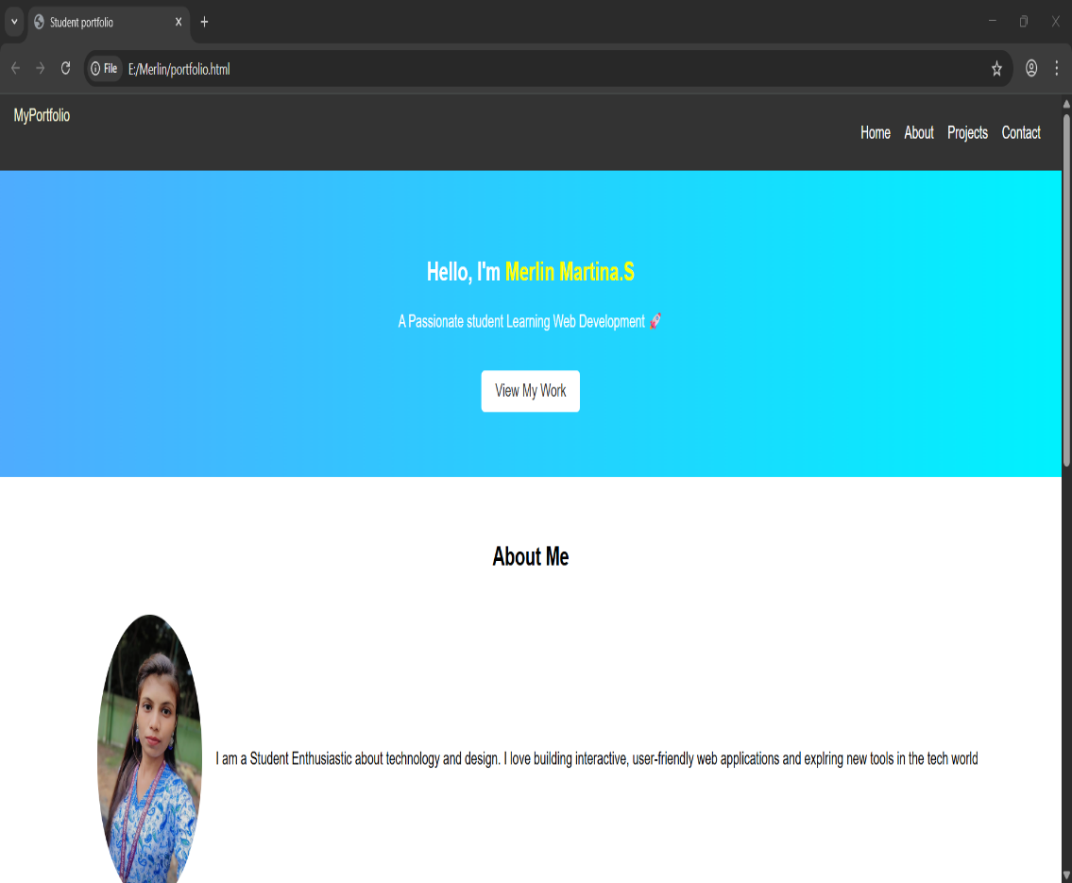
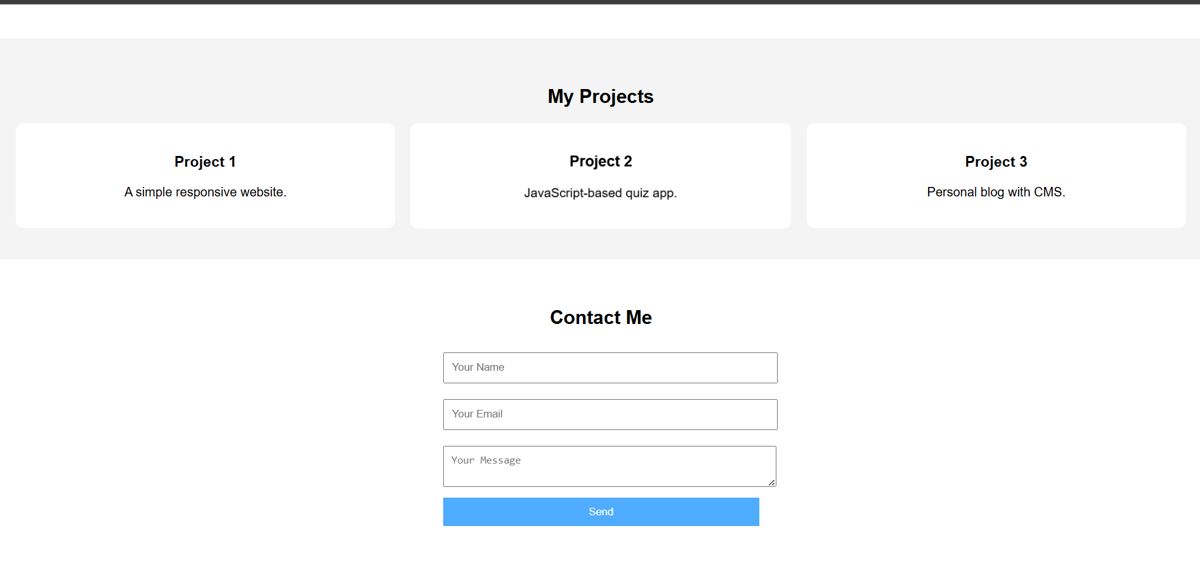
RESULTS AND SCREENSHOTS
3/21/2024 Annual Review
10

Slide 11
CONCLUSION
Digital portfolios help students stand out.
Builds a professional online presence.
Enhances career opportunities and personal branding.
A modern solution to replace traditional resumes.
11

